Slide 1
Discrete Structure
Elementary Combinations, Counting Techniques
Week 11
By
Dr. Rafiullah Khan

Slide 2
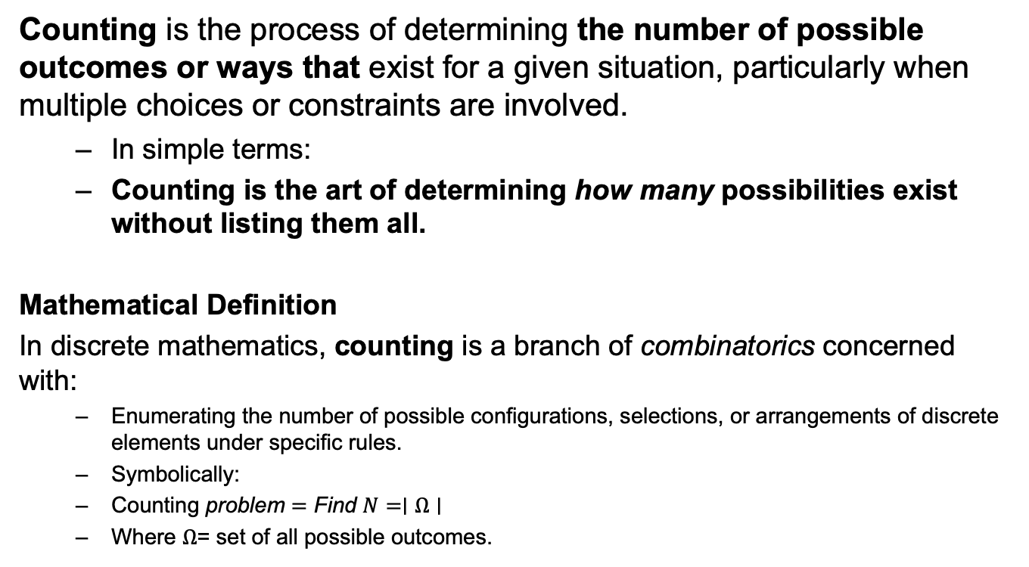
What is Counting?
Counting is the process of determining the number of possible outcomes or ways that exist for a given situation, particularly when multiple choices or constraints are involved.
  In simple terms:
  Counting is the art of determining how many possibilities exist without listing them all.
Mathematical Definition
In discrete mathematics, counting is a branch of combinatorics concerned with:
  Enumerating the number of possible configurations, selections, or arrangements of discrete elements under specific rules.
  Symbolically:
  $\text{Counting} \text{problem}=\text{Find} N=∣Ω∣$
  Where $Ω$= set of all possible outcomes.

Slide 3
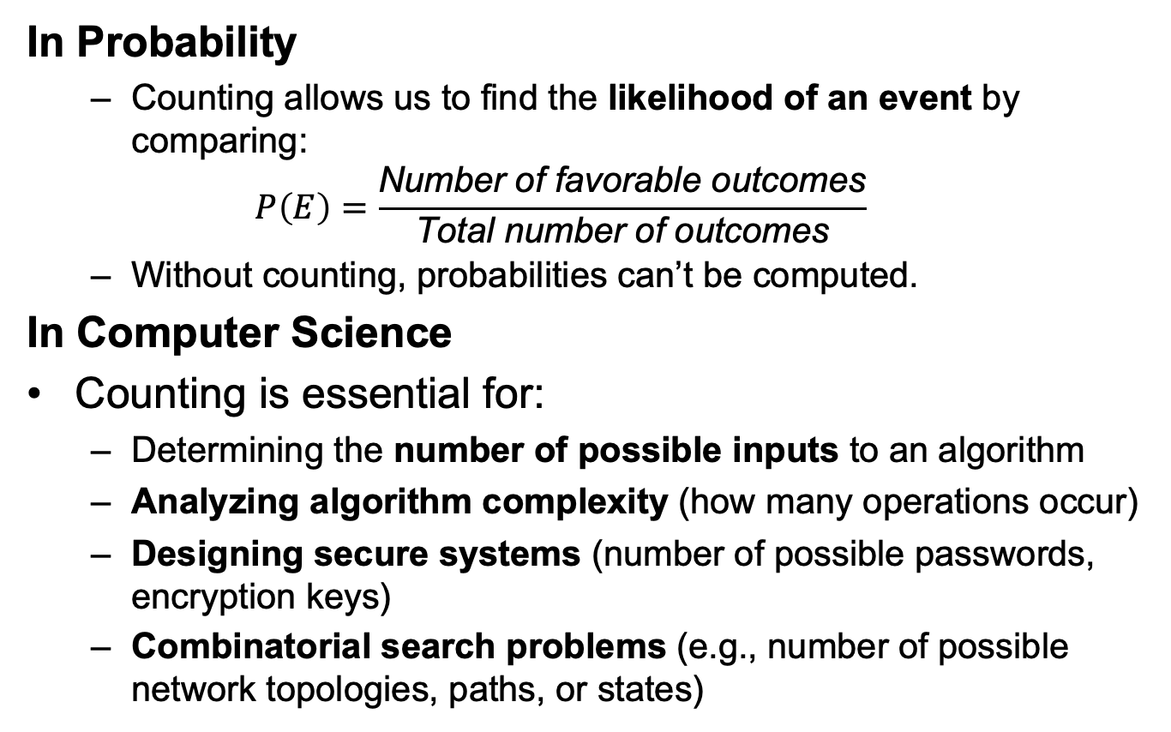
Why Do We Need Counting?
In Probability
  Counting allows us to find the likelihood of an event by comparing:
  $$P\left(E\right)=\frac{\text{Number} \text{of} \text{favorable} \text{outcomes}}{\text{Total} \text{number} \text{of} \text{outcomes}}$$
  Without counting, probabilities can’t be computed.
In Computer Science
Counting is essential for:
  Determining the number of possible inputs to an algorithm
  Analyzing algorithm complexity (how many operations occur)
  Designing secure systems (number of possible passwords, encryption keys)
  Combinatorial search problems (e.g., number of possible network topologies, paths, or states)

Slide 4
Why Do We Need Counting?
In Real Life
Counting helps us answer questions like:
  How many different 4-digit PIN codes can be created?
  How many seating arrangements exist for a group?
  How many subsets can be formed from a dataset?
  How many ways can tasks be scheduled or assigned?

Slide 5
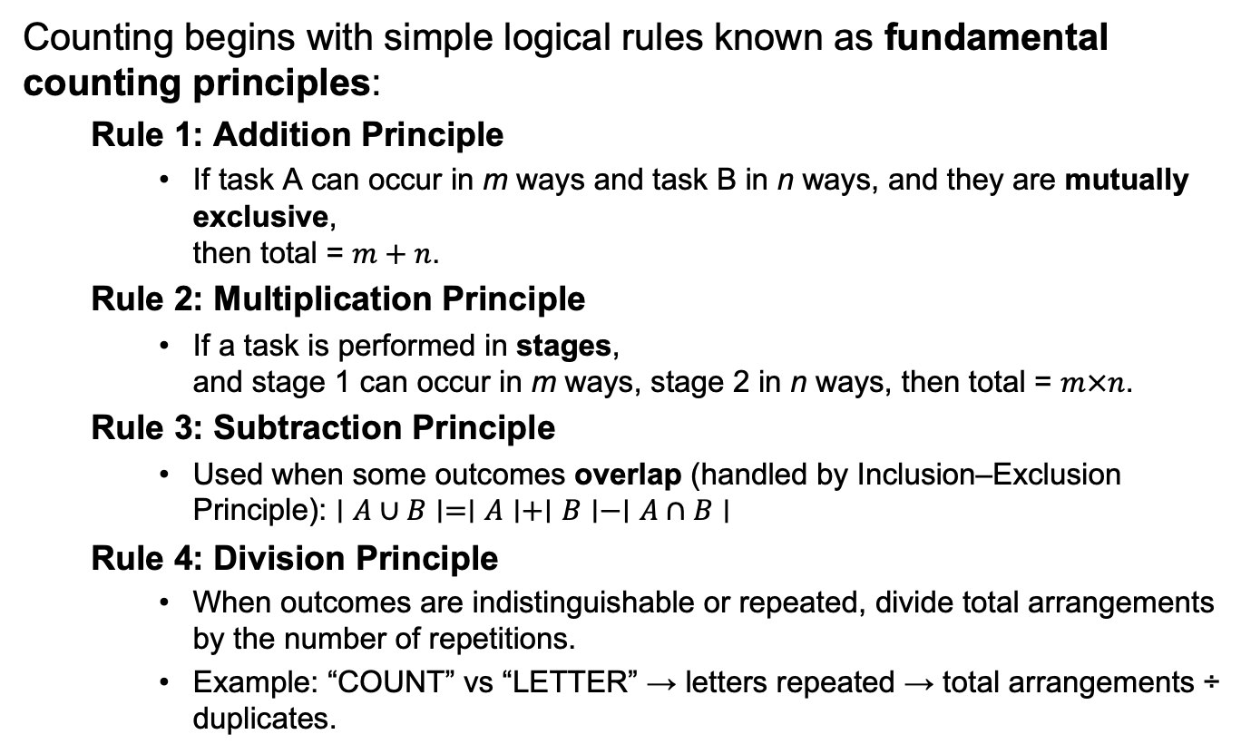
Basic Counting Principles
Counting begins with simple logical rules known as fundamental counting principles:
  Rule 1: Addition Principle
    If task A can occur in m ways and task B in n ways, and they are mutually exclusive,
    then total = $m+n$.
  Rule 2: Multiplication Principle
    If a task is performed in stages,
    and stage 1 can occur in m ways, stage 2 in n ways, then total = $m×n$.
  Rule 3: Subtraction Principle
    Used when some outcomes overlap (handled by Inclusion–Exclusion Principle): $∣A∪B∣=∣A∣+∣B∣−∣A∩B∣$
  Rule 4: Division Principle
    When outcomes are indistinguishable or repeated, divide total arrangements by the number of repetitions.
    Example: “COUNT” vs “LETTER” → letters repeated → total arrangements ÷ duplicates.

Slide 6
Permutations vs. Combinations
Both are ways to count the possibilities
The difference between them is whether order matters or not
Consider a poker hand:
  A♦, 5♥, 7♣, 10♠, K♠
Is that the same hand as:
  K♠, 10♠, 7♣, 5♥, A♦
Does the order the cards are handed out matter?
  If yes, then we are dealing with permutations
  If no, then we are dealing with combinations

Slide 7
Permutations
A permutation is an ordered arrangement of the elements of some set S
  Let S = {a, b, c}
  c, b, a is a permutation of S
  b, c, a is a different permutation of S
An r-permutation is an ordered arrangement of r elements of the set
  A♦, 5♥, 7♣, 10♠, K♠ is a 5-permutation of the set of cards
The notation for the number of r-permutations: P(n,r)
  The poker hand is one of P(52,5) permutations

Slide 8
Permutations
Number of poker hands (5 cards):
  P(52,5) = 52*51*50*49*48 = 311,875,200
Number of (initial) blackjack hands (2 cards):
  P(52,2) = 52*51 = 2,652
r-permutation notation: P(n,r)
  The poker hand is one of P(52,5) permutations

Slide 9
r-permutations example
There are 27 students in the class. How many ways are there for 5 people in this class to give presentations?
  P(27,5) = 27*26*25*24*23 = 9,687,600
  Note that the order they go in does matter in this example!

Slide 10
Permutation formula proof
There are n ways to choose the first element
  n-1 ways to choose the second
  n-2 ways to choose the third
  …
  n-r+1 ways to choose the r^{th} element
By the product rule, that gives us:
P(n,r) = n(n-1)(n-2)…(n-r+1)

Slide 11
Permutations vs. r-permutations
r-permutations: Choosing an ordered 5 card hand is P(52,5)
  When people say “permutations”, they almost always mean r-permutations
    But the name can refer to both
Permutations: Choosing an order for all 52 cards is P(52,52) = 52!
  Thus, P(n,n) = n!

Slide 12
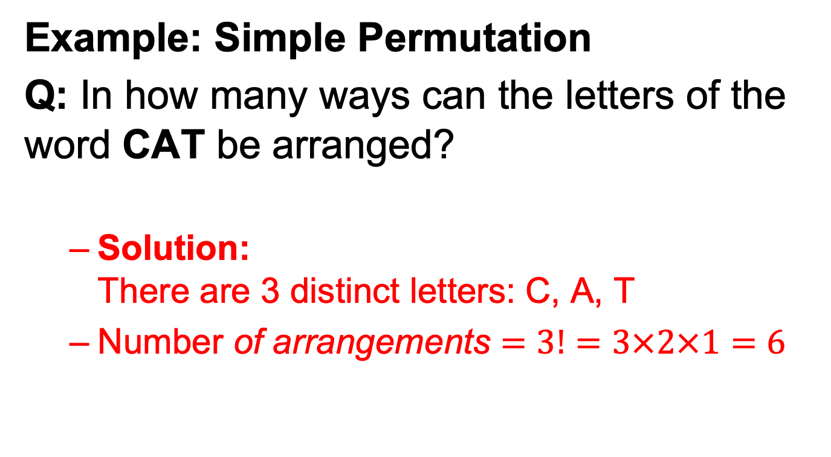
Permutations Questions
Example: Simple Permutation
Q: In how many ways can the letters of the word CAT be arranged?
  Solution:
  There are 3 distinct letters: C, A, T
  $\text{Number} \text{of} \text{arrangements}=3!=3×2×1=6$

Slide 13
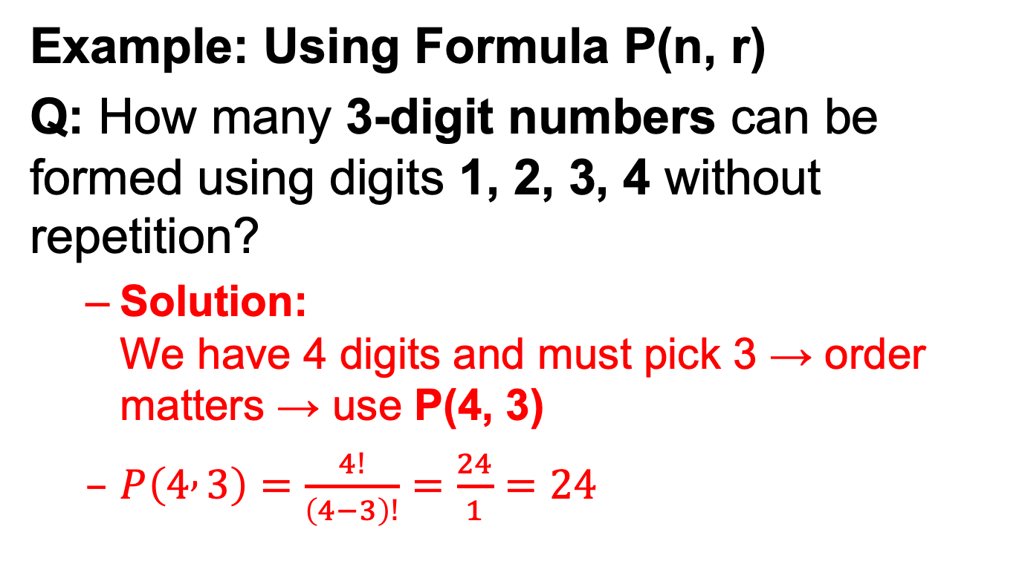
Permutations Questions
Example: Using Formula P(n, r)
Q: How many 3-digit numbers can be formed using digits 1, 2, 3, 4 without repetition?
  Solution:
  We have 4 digits and must pick 3 → order matters → use P(4, 3)
  $P\left(4 , 3\right)=\frac{4!}{\left(4−3\right)!}=\frac{24}{1}=24$

Slide 14
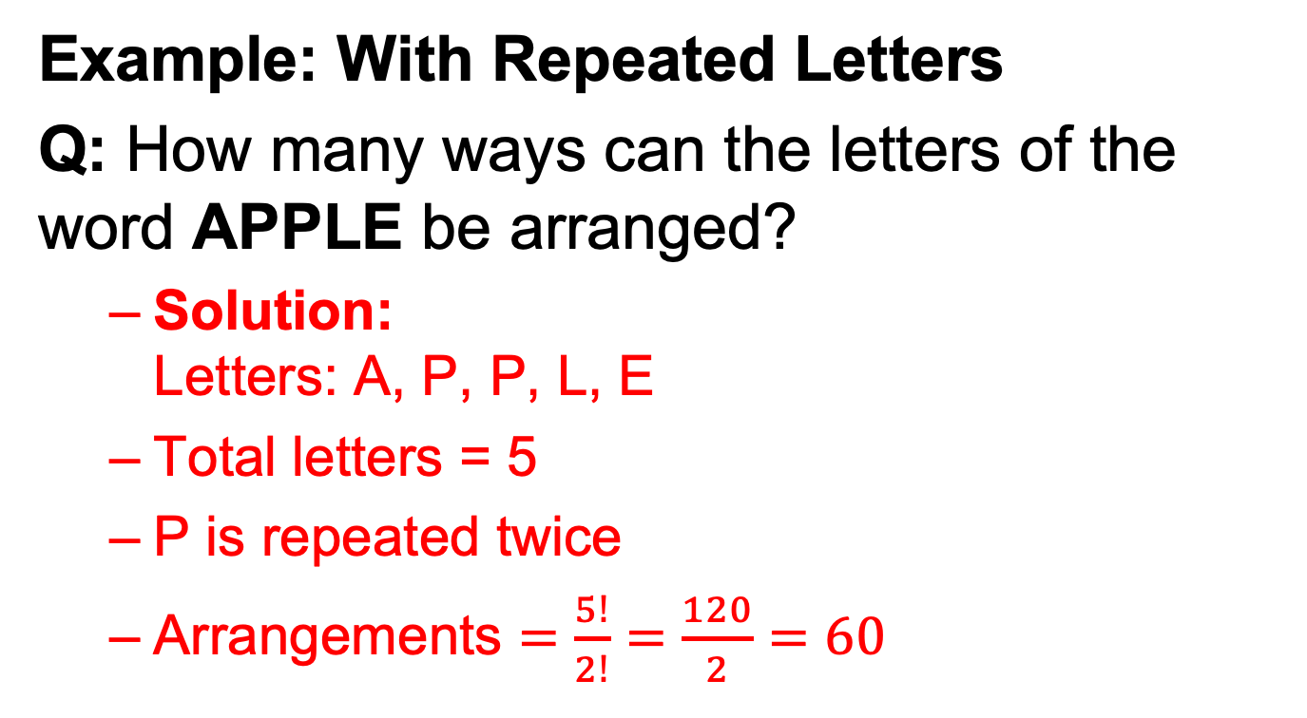
Permutations Questions
Example: With Repeated Letters
Q: How many ways can the letters of the word APPLE be arranged?
  Solution:
  Letters: A, P, P, L, E
  Total letters = 5
  P is repeated twice
  $\text{Arrangements}=\frac{5!}{2!}=\frac{120}{2}=60$

Slide 15
Sample question
How many permutations of {a, b, c, d, e, f, g} end with a?
  Note that the set has 7 elements
The last character must be a
  The rest can be in any order
Thus, we want a 6-permutation on the set {b, c, d, e, f, g}
P(6,6) = 6! = 720
Why is it not P(7,6)?

Slide 16
Combinations
What if order doesn’t matter?
In poker, the following two hands are equivalent:
  A♦, 5♥, 7♣, 10♠, K♠
  K♠, 10♠, 7♣, 5♥, A♦
The number of r-combinations of a set with n elements, where n is non-negative and 0≤r≤n is:

Slide 17
Combinations example
How many different poker hands are there (5 cards)?
How many different (initial) blackjack hands are there?

Slide 18
Combination formula proof
Let C(52,5) be the number of ways to generate unordered poker hands
The number of ordered poker hands is P(52,5) = 311,875,200
The number of ways to order a single poker hand is P(5,5) = 5! = 120
The total number of unordered poker hands is the total number of ordered hands divided by the number of ways to order each hand
Thus, C(52,5) = P(52,5)/P(5,5)

Slide 19
Combination formula proof
Let C(n,r) be the number of ways to generate unordered combinations
The number of ordered combinations (i.e. r-permutations) is P(n,r)
The number of ways to order a single one of those r-permutations P(r,r)
The total number of unordered combinations is the total number of ordered combinations (i.e. r-permutations) divided by the number of ways to order each combination
Thus, C(n,r) = P(n,r)/P(r,r)

Slide 20
Combination formula proof

Slide 21
Bit strings
How many bit strings of length 10 contain:
exactly four 1’s?
  Find the positions of the four 1’s
  Does the order of these positions matter?
    Nope!
    Positions 2, 3, 5, 7 is the same as positions 7, 5, 3, 2
  Thus, the answer is C(10,4) = 210
at most four 1’s?
  There can be 0, 1, 2, 3, or 4 occurrences of 1
  Thus, the answer is:
    C(10,0) + C(10,1) + C(10,2) + C(10,3) + C(10,4)
    = 1+10+45+120+210
    = 386

Slide 22
Bit strings
How many bit strings of length 10 contain:
at least four 1’s?
  There can be 4, 5, 6, 7, 8, 9, or 10 occurrences of 1
  Thus, the answer is:
    C(10,4) + C(10,5) + C(10,6) + C(10,7) + C(10,8) + C(10,9) + C(10,10)
    = 210+252+210+120+45+10+1
    = 848
  Alternative answer: subtract from 2¹⁰ the number of strings with 0, 1, 2, or 3 occurrences of 1
an equal number of 1’s and 0’s?
  Thus, there must be five 0’s and five 1’s
  Find the positions of the five 1’s
  Thus, the answer is C(10,5) = 252

Slide 23
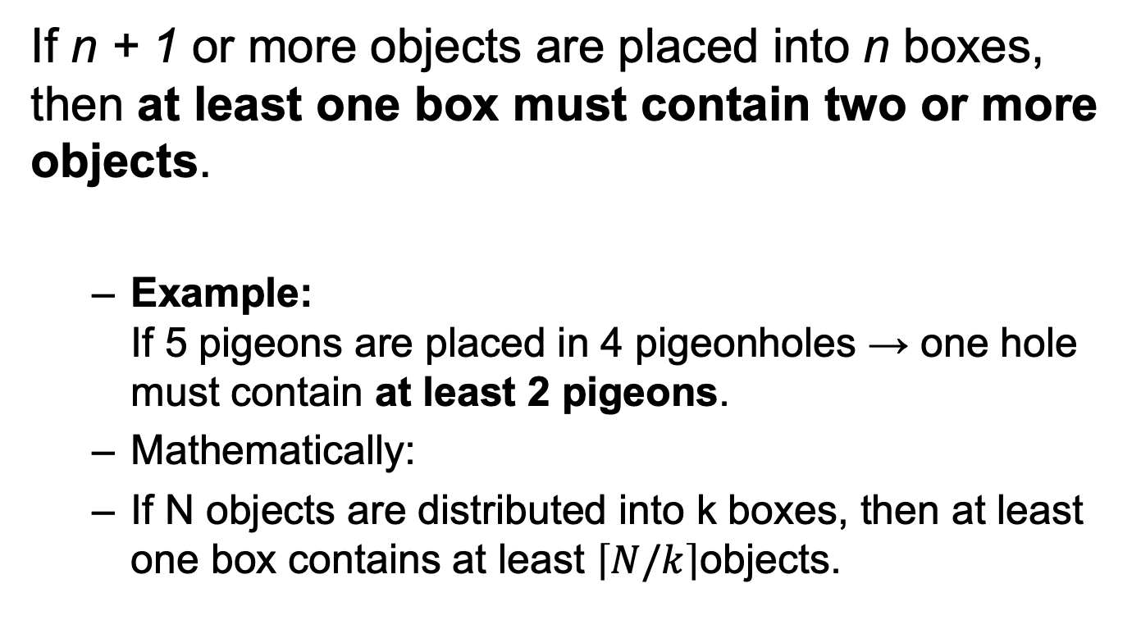
Pigeonhole Principle
If n + 1 or more objects are placed into n boxes, then at least one box must contain two or more objects.
  Example:
  If 5 pigeons are placed in 4 pigeonholes → one hole must contain at least 2 pigeons.
  Mathematically:
  If N objects are distributed into k boxes, then at least one box contains at least $\left\lceil N/k\right\rceil$objects.

Slide 24
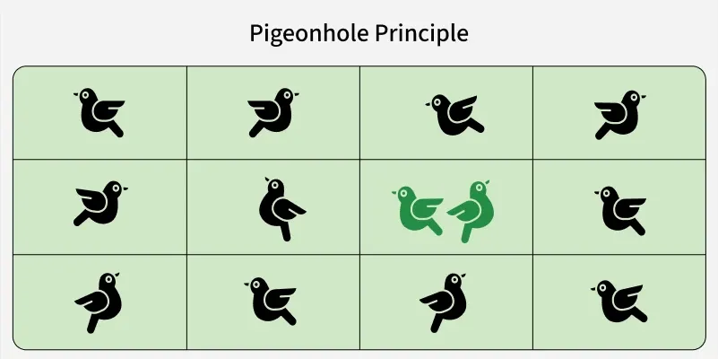

Slide 25
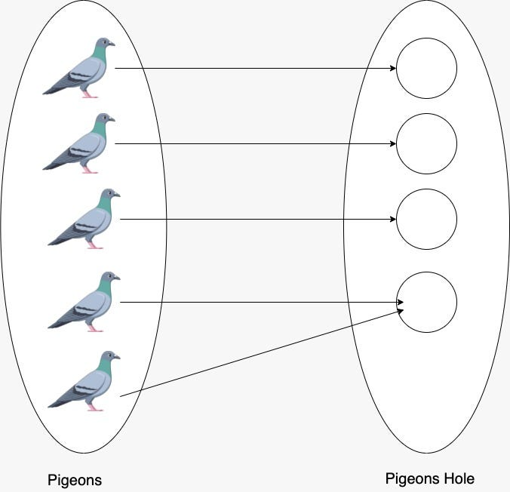

Slide 26
Examples
Example 1:
You have 13 pairs of socks in 4 drawers.
→ By PHP, at least one drawer has ⌈13/4⌉ = 4 pairs.
Example 2:
There are 367 people in a room.
→ Since there are only 366 possible birthdays, at least two people share a birthday.

Slide 27
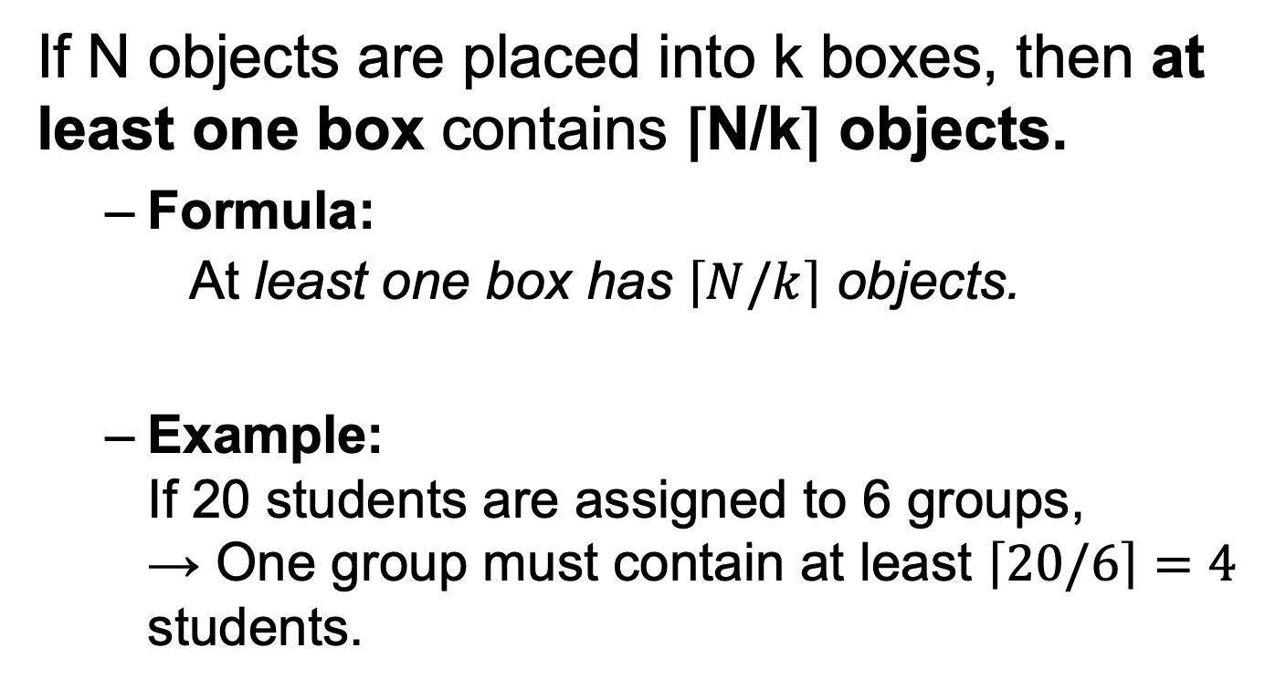
Generalized Pigeonhole Principle
If N objects are placed into k boxes, then at least one box contains ⌈N/k⌉ objects.
  Formula:
  $\text{At} \text{least} \text{one} \text{box} \text{has} \left\lceil N/k\right\rceil \text{objects}\text{.}$
  Example:
  If 20 students are assigned to 6 groups,
  → One group must contain at least $\left\lceil 20/6\right\rceil =4$ students.

Slide 28
Question
What is the minimum number of students required in a Discrete Mathematics class to be sure that at least six will receive the same grade, if there are five possible grades: A, B, C, D, and F?

Slide 29
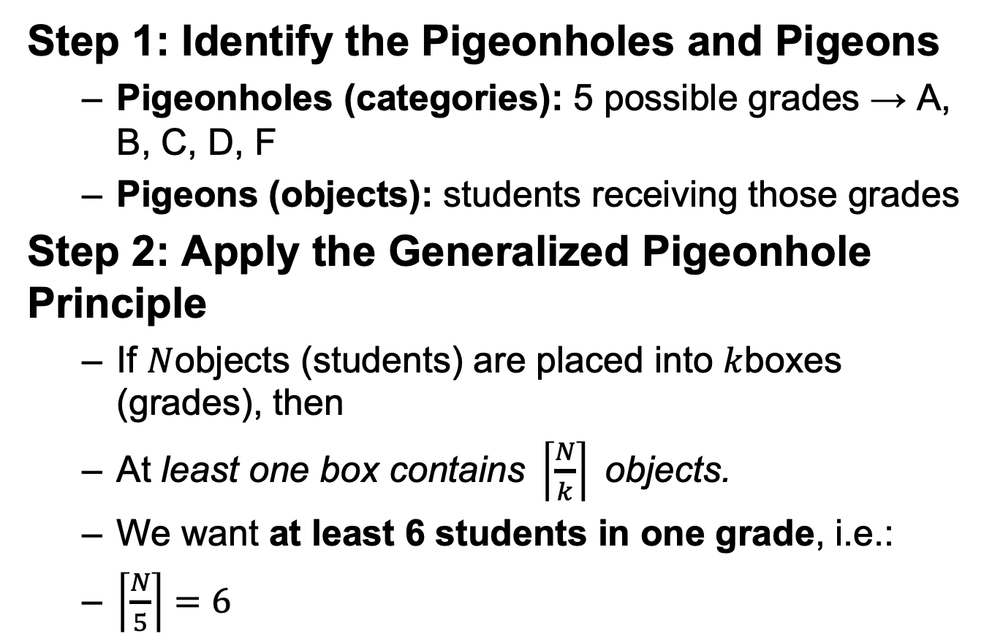
Step 1: Identify the Pigeonholes and Pigeons
  Pigeonholes (categories): 5 possible grades → A, B, C, D, F
  Pigeons (objects): students receiving those grades
Step 2: Apply the Generalized Pigeonhole Principle
  If $N$objects (students) are placed into $k$boxes (grades), then
  $\text{At} \text{least} \text{one} \text{box} \text{contains} \left\lceil \frac{N}{k}\right\rceil \text{objects}\text{.}$
  We want at least 6 students in one grade, i.e.:
  $\left\lceil \frac{N}{5}\right\rceil =6$

Slide 30
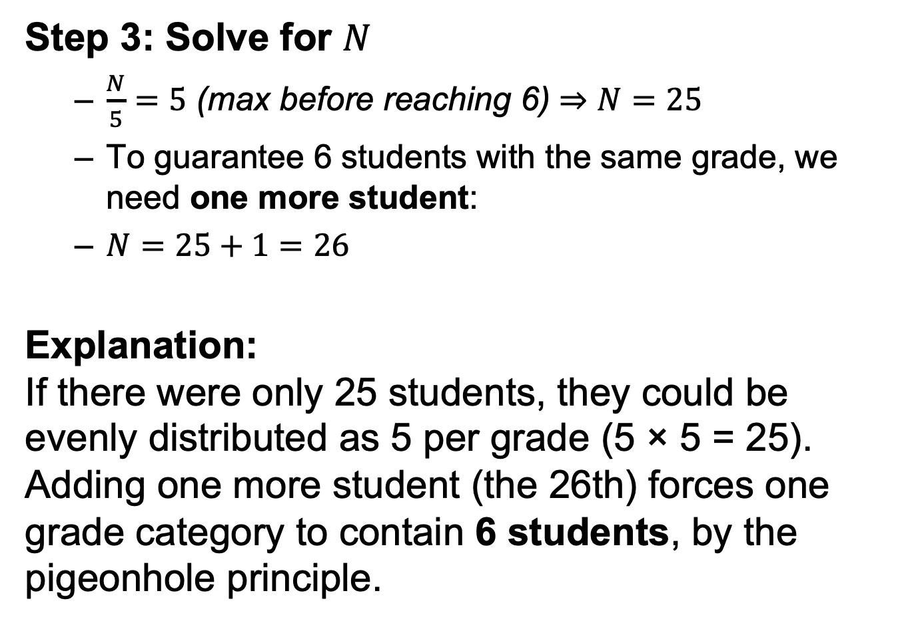
Step 3: Solve for $N$
  $\frac{N}{5}=5\text{ (}\text{max} \text{before} \text{reaching}\text{ 6)}⇒N=25$
  To guarantee 6 students with the same grade, we need one more student:
  $N=25+1=26$
Explanation:
If there were only 25 students, they could be evenly distributed as 5 per grade (5 × 5 = 25). Adding one more student (the 26th) forces one grade category to contain 6 students, by the pigeonhole principle.

